Slide 1
PMJ Test
Presentation
He Zhuang 2023/01/31

Slide 2
Outline
Question 1:
Data preprocess
Calculation Method
Question 2:
Data preprocess
Data visualization and insights
Result
Potencial Improvement:
Question 3:
DBSCAN on Passenger cluster

Slide 3
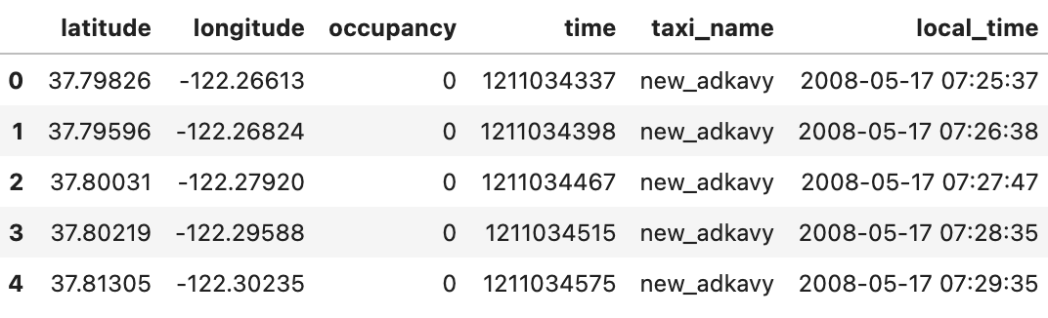
Question 1:
Data preprocess
Data preprocess,
Drop null
Change to unix time to (San Francisco) local time
Add a “taxi_name” column
New

Slide 4

Question 1:
Calculation
Question 1: To calculate the potential for a yearly reduction in CO2 emissions, caused by the taxi cabs roaming without passengers. In your calculation, please assume that the taxicab fleet is changing at the rate of 15% per month (from combustion engine-powered vehicles to electric vehicles). Assume also that the average passenger vehicle emits about 404 grams of CO2 per mile.
Answer: 4311,476,496 gram = 4311 ton
Calculate formula: $\overset{12}{\underset{k=1}{∑}}E_{k}*(13-k)$ , where $E_{k}$ = the total CO2 emission of taxi changed in k month
Calculate the roaming distance (in mile) without passengers for each taxi
Use euclidean distance of continuous two records to appropriate actual distance
Convert the distance to CO2
Sort the above result, and for each month, select top 15% taxi with the longest roaming distance to change to electric vehicles
Calculate $E_{k}$ of top 15% taxis
Calculate final result of CO2 by above formula
Assumption:
The taxi emit same CO2 regardless of month

Slide 5
Question 2:
Data preprocess
Data preprocess,
Drop null
Change to unix time to (San Francisco) local time
Add a “taxi_name” column
Add a maker “in_out” column when passenger getting “in” or “out”
Remove “longitude” and “latitude” outlier record (>99.5% or <0.5%)
Add weekdays “day” and “hour” columns to specify time slot
{0:'Monday', 1:'Tuesday', 2:'Wednesday', 3:'Thursday', 4:'Friday', 5:'Saturday', 6:’Sunday’}
Add drive_id for each drive (including w/o passengers)
New columns

Slide 6
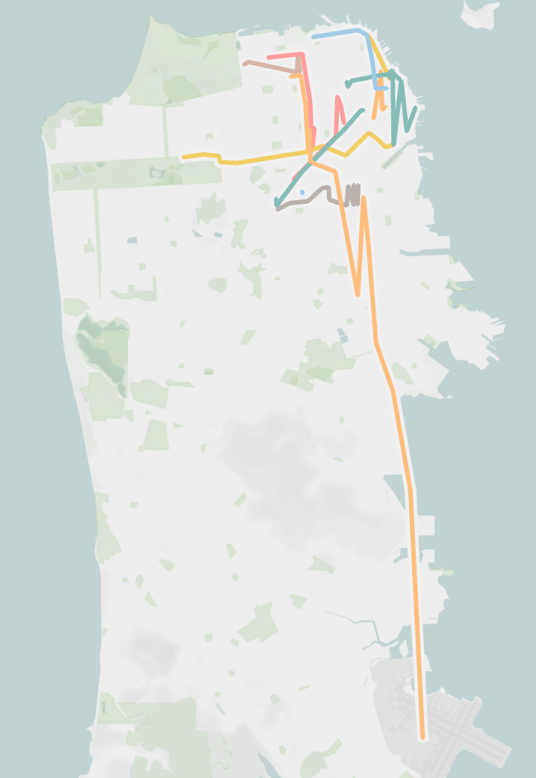
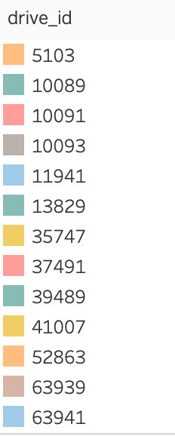
Question 2:
Data visualization and insights
Some drive route with passengers

Slide 7
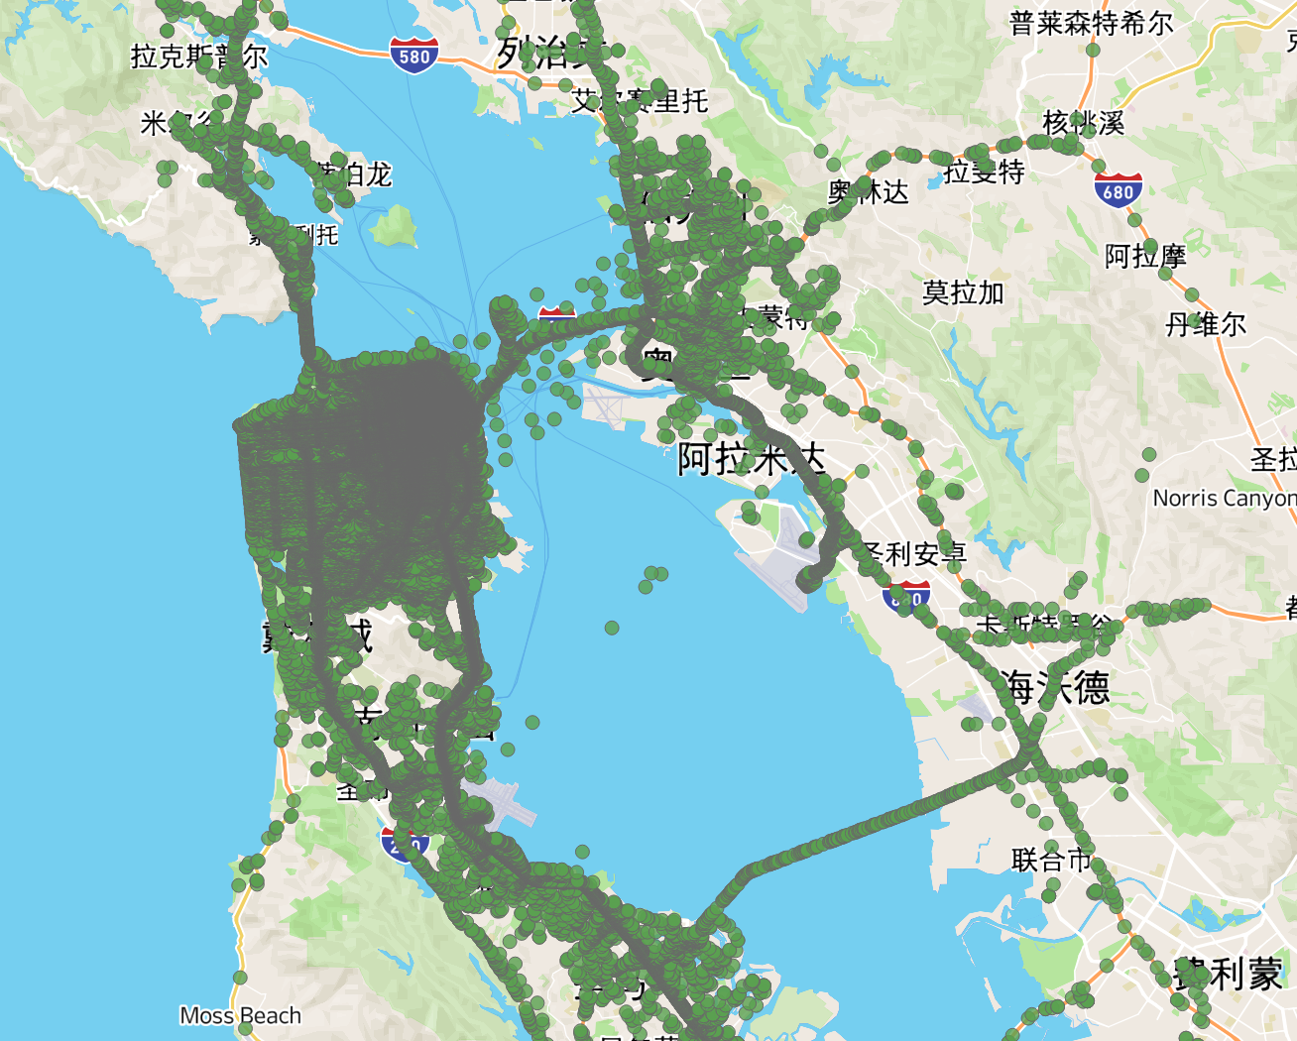
Question 2:
Data visualization and insights
Range of taxi with passenger

Slide 8
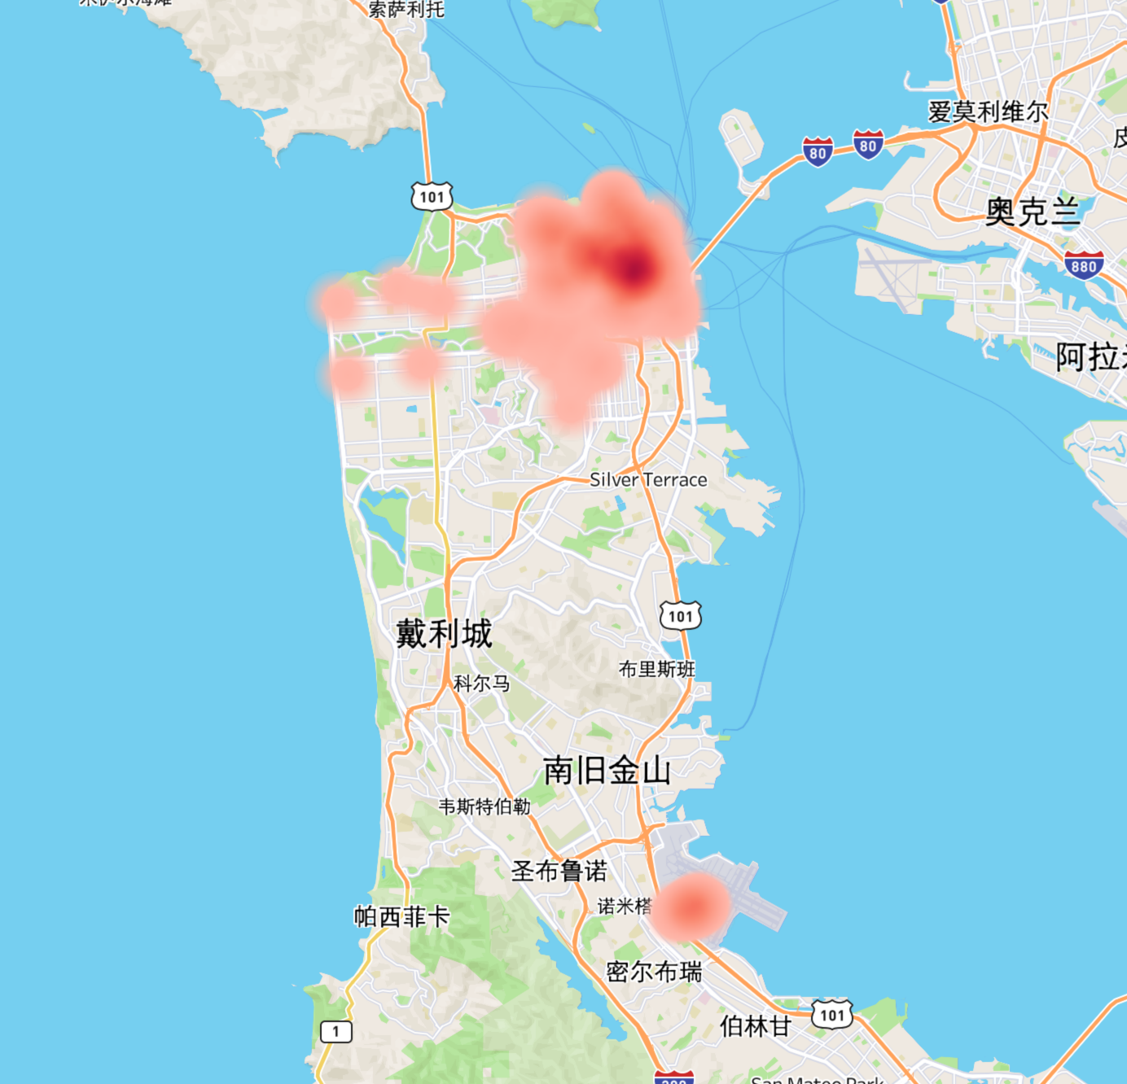
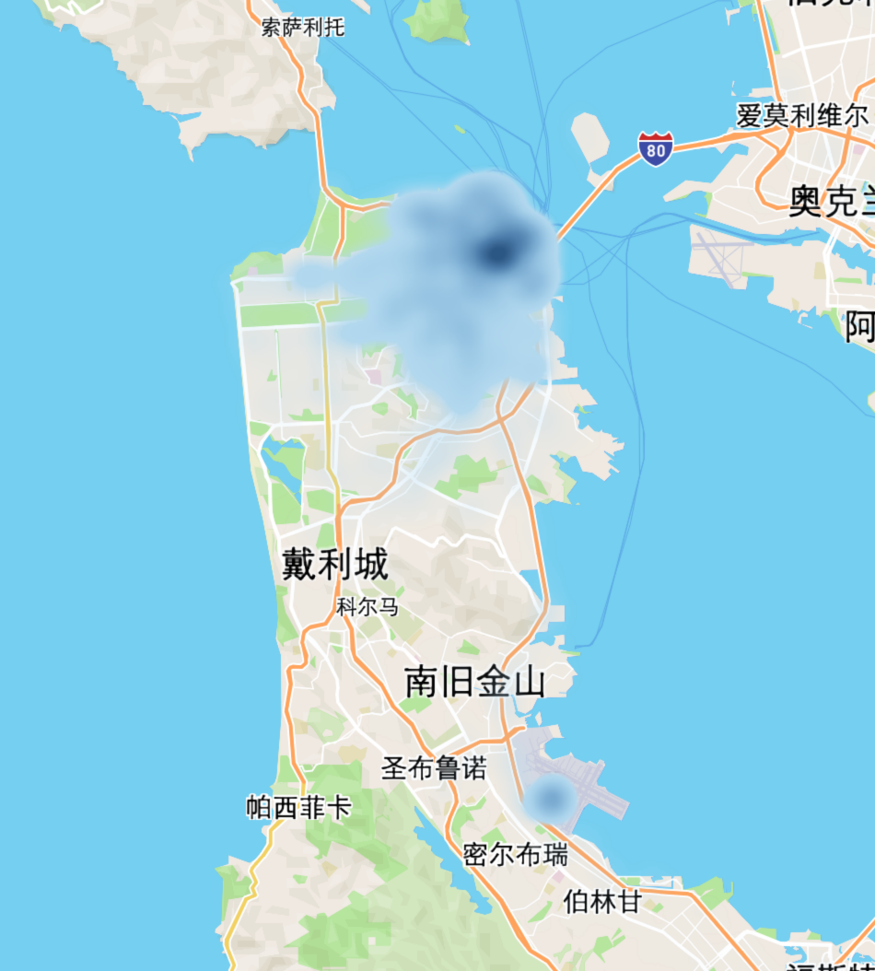
Question 2:
Data visualization and insights
Heat map of location taxi picking up (in) or dropping off (out) a passenger (Data May 17-21)
The hot area are very centralized
The locations of in and out are overlapped well,
We can assume the generally a driver should get a passenger near the place passenger leave.
Which means the distance shouldn’t be too long
picking up passenger point heat map
Dropping off point heat map

Slide 9
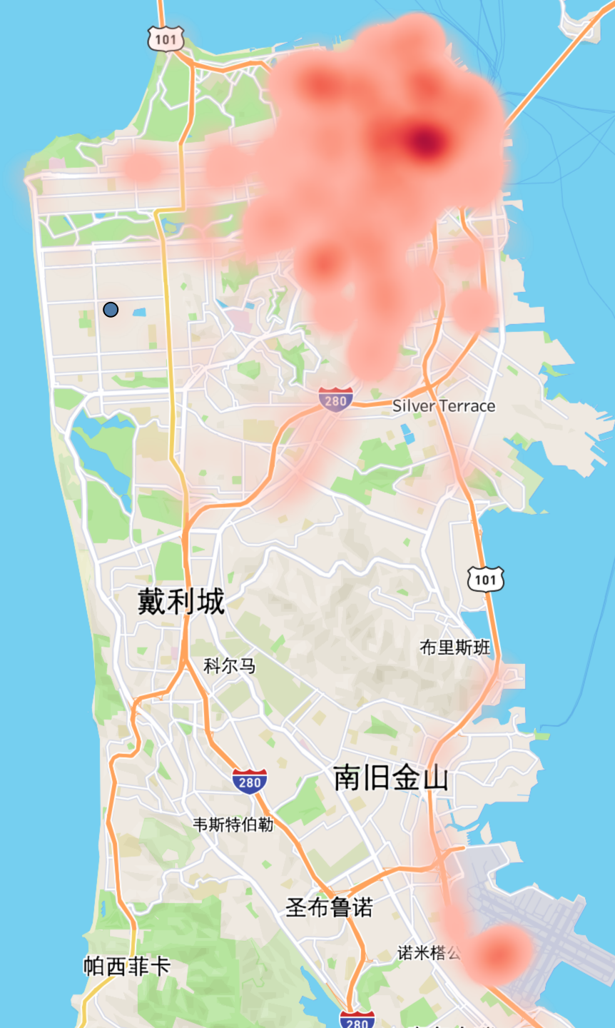
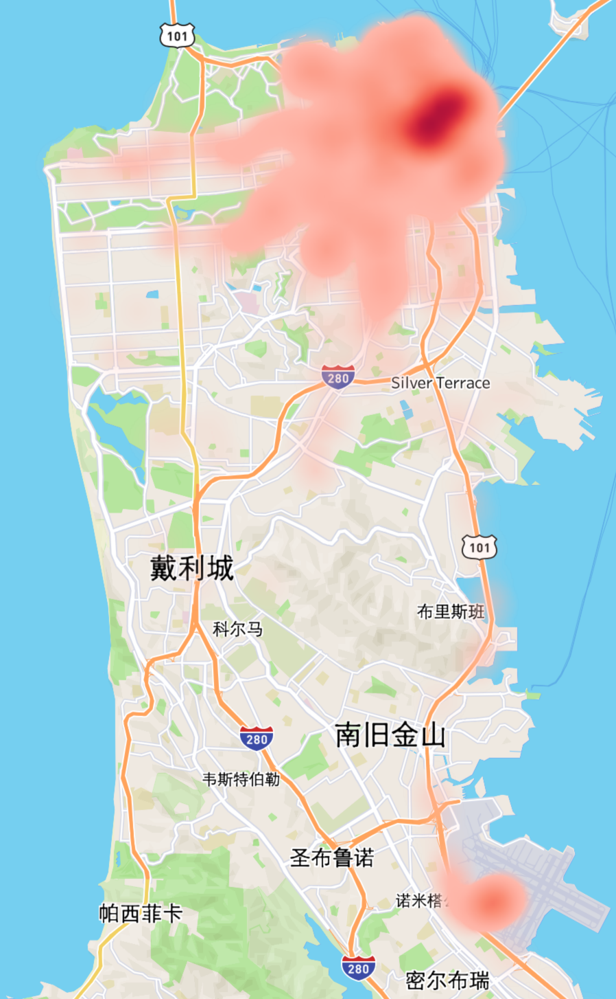
Question 2:
Data visualization and insights
Passengers distribution differs from weekday to weekend
During weekend passenger are dispersed
During weekdays passengers are centralized
20080601 (Sun.)
20080603 (Wed.)

Slide 10
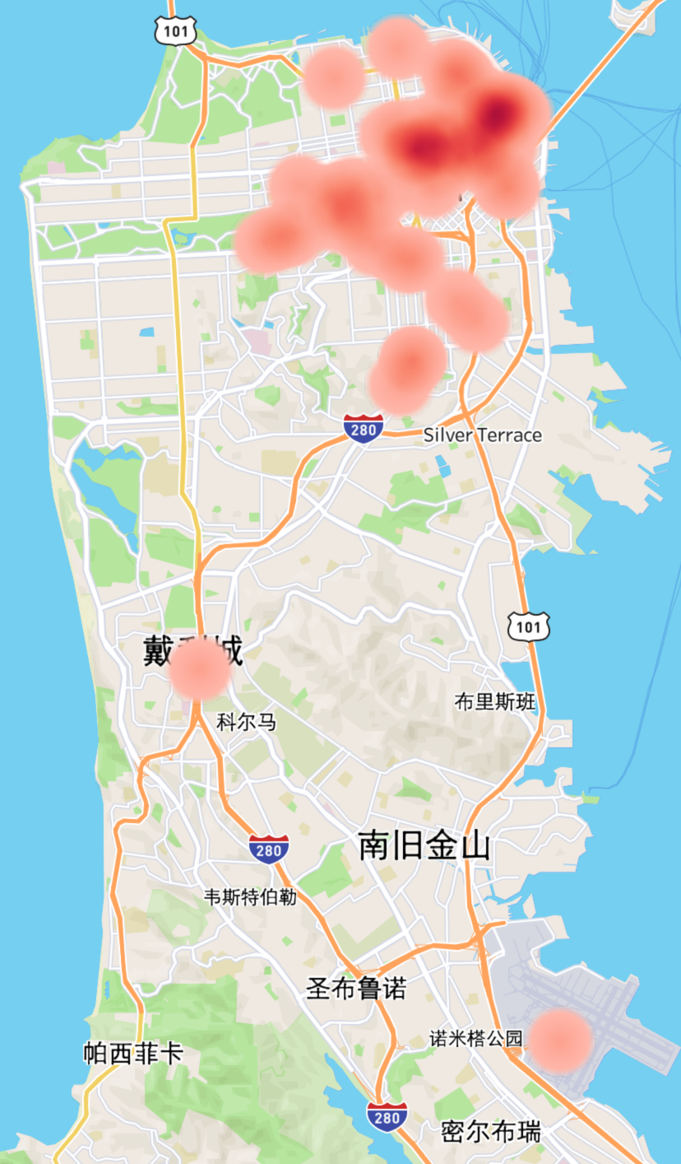
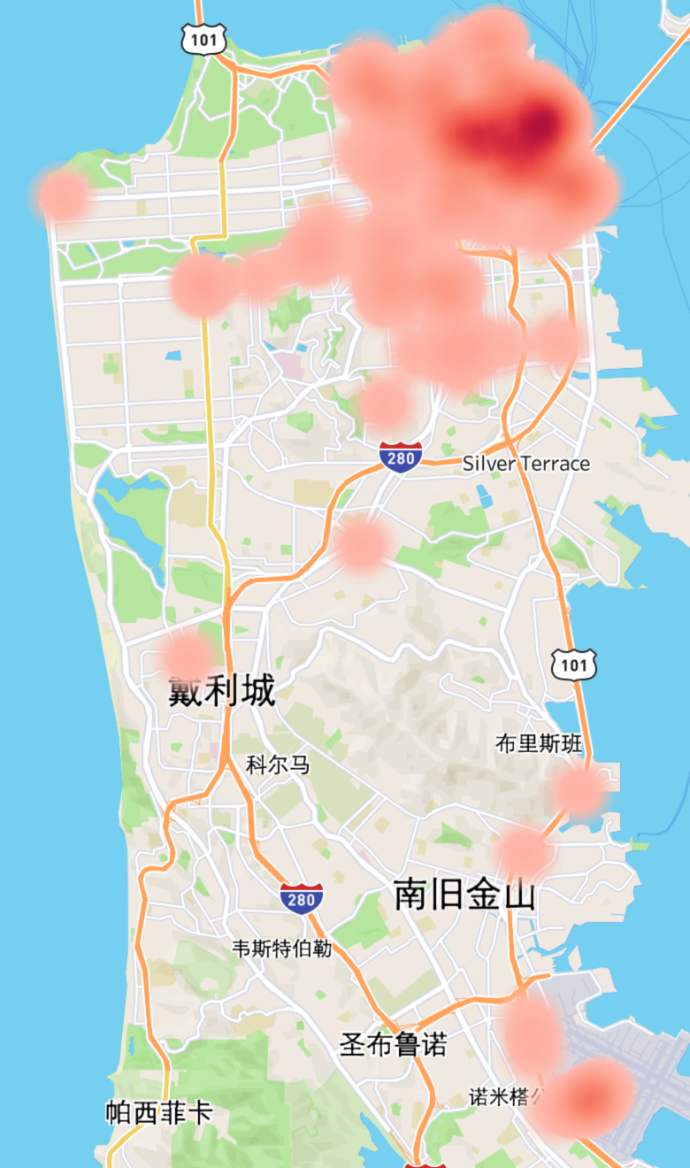
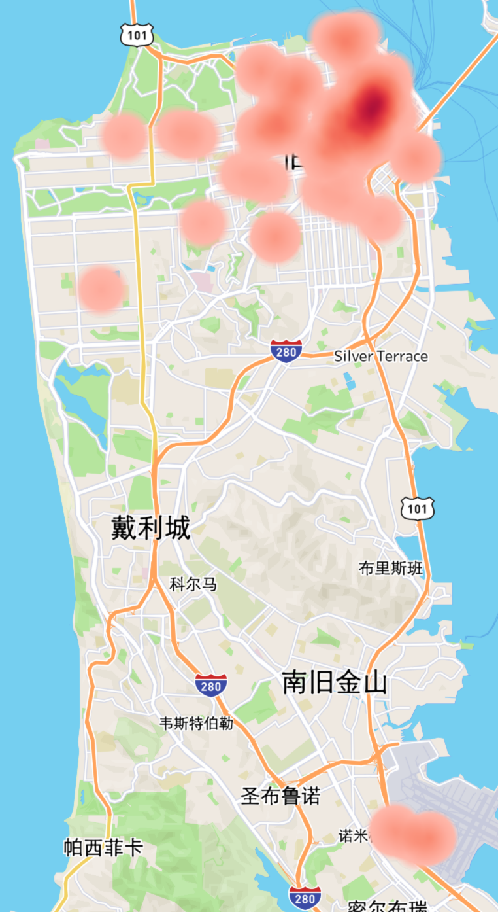
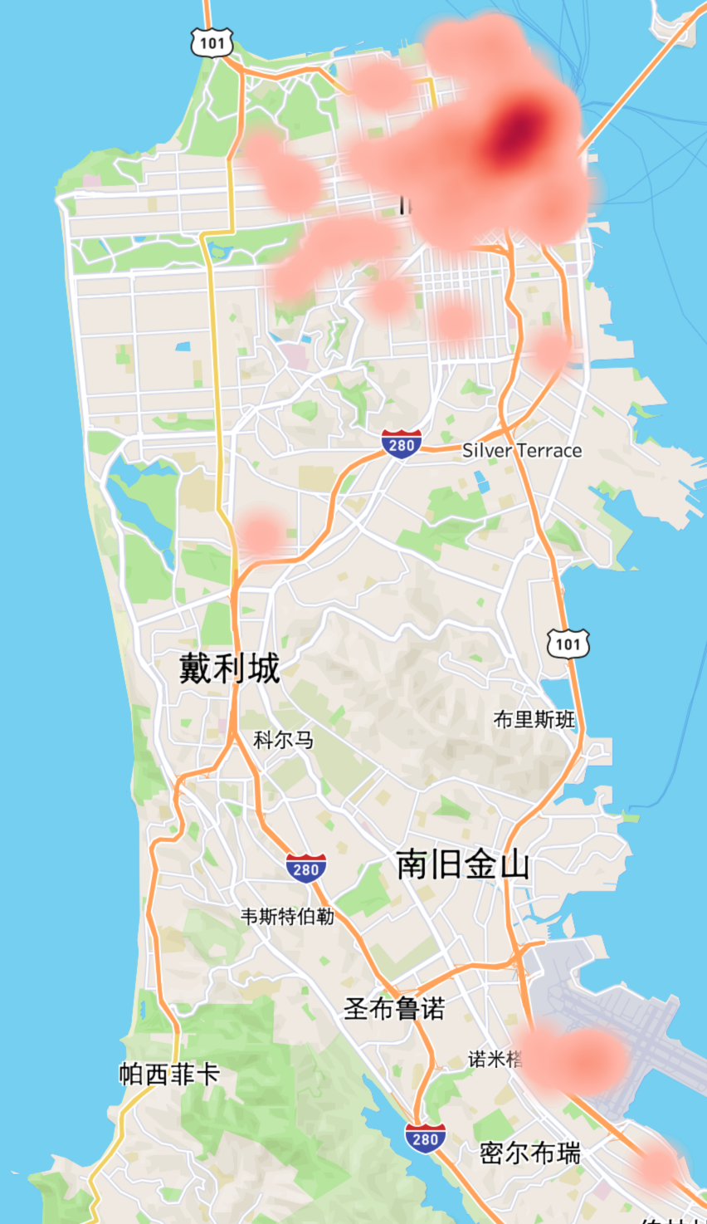
Question 2:
Data visualization and insights
Passengers distribution differs by hours
Prediction should be time-slot specific
00:00
Centralized
Less
06:00
Dispersed
More
12:00
Centralized
Normal
00:00
Centralized
Less

Slide 11
Question 2:
Data preprocess
Solution Introduction
Grid based: Split whole map to 1km*1km grid ( can be adjusted)
For each cell (grid), based on the historical data, calculate:
Passenger density$ρ$ : (Day and time Specific ) (positive)
For each weekday and hour, calculate density$ρ$ (passengers #)
Density can be the metric as needs
Distance from current driver to other cells $d$: (negative)
Competitiveness (probability): $P_{t}=\frac{\text{empty taxi num around the cell}}{\text{taxi num around the cell}}$ (negative)
Final Score: $S=\frac{w_{ρ}ρ}{(1+P_{t})×w_{d}d}$, where hyper parameter $w_{ρ}\text{and}w_{d}$ is the weight to adjust the importance of $ρ\text{and}d$
This formula jointly consider the most important factor $ρ$, $d$, $P_{t}$
Possible to dynamic adjust score according to needs
Rank and select the top 1 cell location to info current driver
Model (input, output)
Input |  | Output | Output (optional)
Day, Time | Current driver coordinates | The coordinate of top 1 cell | The coordinates of top k cell
Mon. , 8:00 am | (-122.40106, 37.79177) | (-122.40106, 37.79177) | (-122.40106, 37.80177) (-122.40106, 37.81177) (-122.41106, 37.79177)

Slide 12
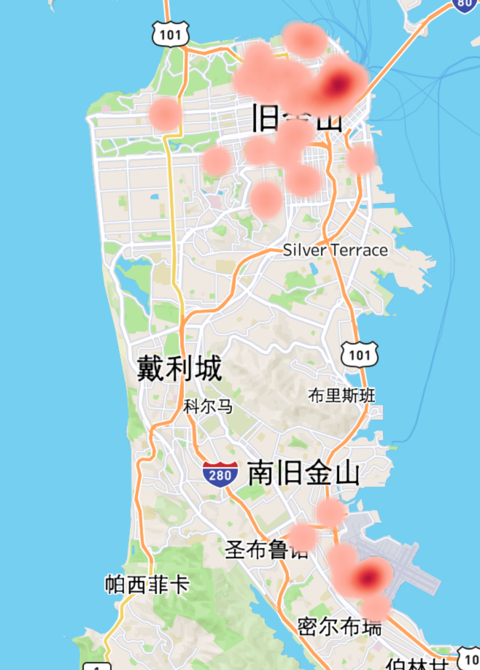
Question 2:
Data preprocess
Result Sample
From the two samples, we can the model could give a next place with high passenger density
The result is near to current position, not just point at highest density result
Which mean distance factor works
By these two samples, the effectiveness of this model is roughly verified
Sample 1
Model (input, output)
Samples | Input (day, time, lon, lat) |  | Output (next place)
#1 | Mon. 12:00 | (-122.40106, 37.79177) | (-122.4232, 37.7729)
#2 | Mon. 12:00 | (-122.4064, 37.6471) | (-122.3882, 37.6162)
Sample 2

Slide 13
Question 2:
Potencial Improvement:
Sting grid clustering could be used to improve density calculation
More features could be considered
Average wait time
Average trip time if taking passenger from this cell
Average empty taxi #
Distance to the target cell
…
Other cost Function (metric) = (time to target cell + average waiting time in target cell) / Average trip time
Practically the street information must be included in recommendation system
Reinforce learning could be used to optimize this problem

Slide 14
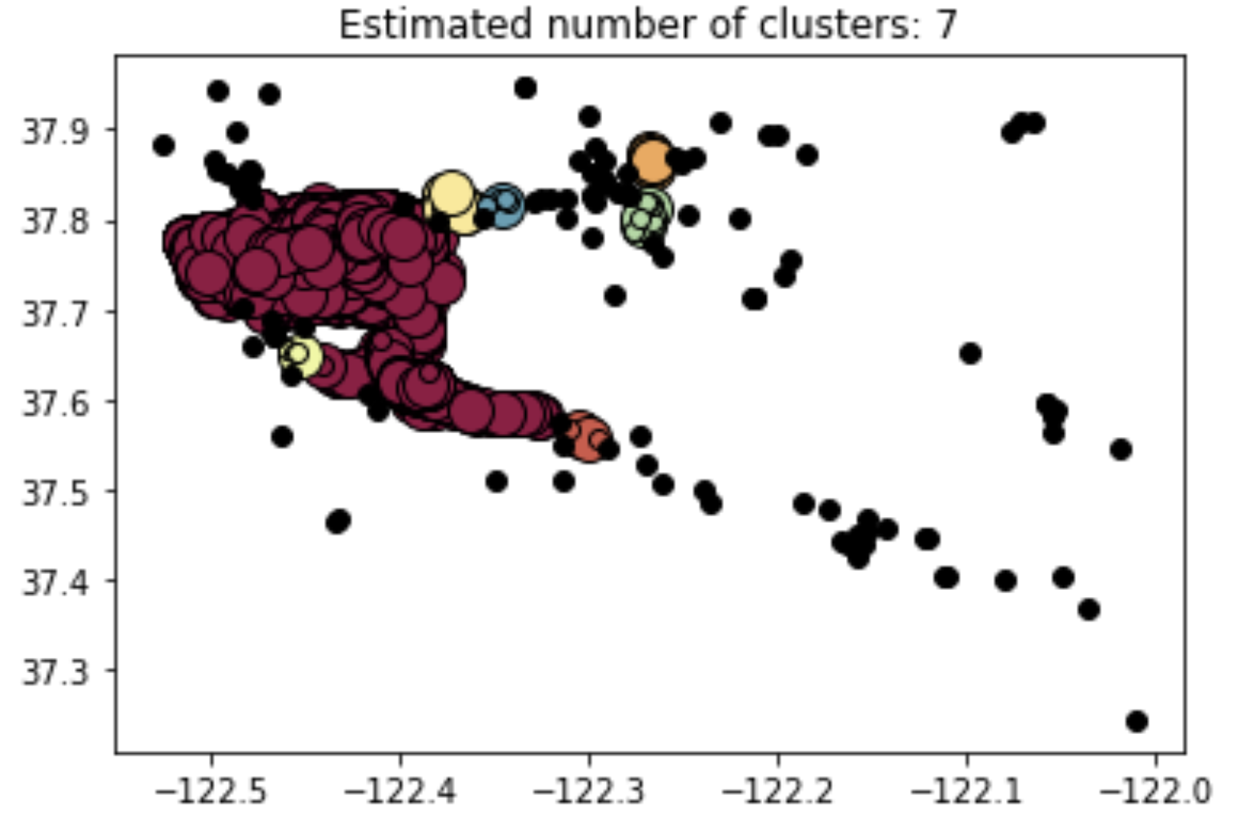
Question 3:
DBSCAN on passengers density
DBSCAN on passengers location is imlemented(on sampled data)
Totally 7 cluster are found
There is huge cluster include mostly samples, considering the limited hot area (from heat map), this is reasonable.
There are other 6 clusters, there is relatively good customer need founding
So from Company point of view, we can specifically to send some taxies to the clusters area to better meet customer needs

